Slide 1
A Clinical Ovarian Cancer Histotype Classifier Using Gene Expression Data for Improved Diagnostic Accuracy

Slide 2
Background
Ovarian cancer is a series of distinct diseases typically identified by their histopathological appearance as high-grade serous (HGSC), low-grade serous (LGSC), endometrioid (ENOC), clear cell (CCC), and mucinous (MC) carcinomas
Class prediction modeling can be used to build a histotype classifier based on differential gene expression profiles between different classes of tumors
The NanoString nCounter platform measures mRNA abundances and has been used in other clinical multi-gene predictors
NanoString is reliable for testing FFPE samples, which is crucial for clinical implementation

Slide 3
Modeling considerations
Multivariate modeling approaches use a subset of genes to assign a patient to a particular class
Development and validation
Models suffer from a risk of over fitting whereby the classification algorithm performs well on the samples from which it was built but poorly on independent samples
Class imbalance
HGSC is the dominant ovarian cancer histotype (70%)
Classifier algorithms tend to favour the majority class and special considerations must be made to properly train a classifier
Normalization between CodeSets
NanoString has demonstrated rapid, reliable and reproducible results within the same batch of reagents (CodesSets)
Large batch-to-batch variability has been observed and need to be accounted for

Slide 4
Objective
To develop and validate an ovarian cancer histotype classifier using NanoString gene expression data that establishes a method:
For creating and validating multiple reference sets to normalize results between CodeSets
That takes into account class imbalance when developing the classification algorithm
This classifier provides a means to rapidly and objectively classify ovarian cancer histotypes from mRNA extracted from clinical FFPE tumor samples on an individual tumor basis that can be integrated into a clinical operational pipeline for improved diagnostics and ultimately better patient outcomes

Slide 5
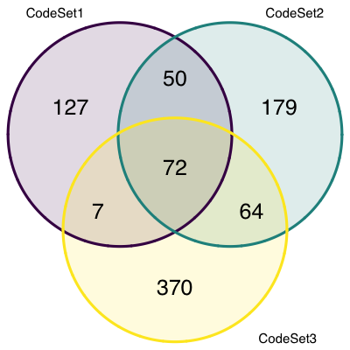
Methods: NanoString
NanoString CodeSets contained:
A mix of all probes of interest
6 pos controls spiked-in at fixed proportional [ ]
8 neg controls (probes without corresponding target)
Gene targets
5 housekeeping genes
CodeSet1 – 412 samples and covered 275 genes
CodeSet2 – 1223 samples and covered 384 genes
CodeSet3 – 5424 samples and covered 532 genes
*excluding housekeeping and controls
Notes:
Pos controls used as QC for limit of detection
Genes in Codesets - remove uninformative genes, add additional candidates

Slide 6

Normalization to housekeeping genes
The first normalization step was to normalize all endogenous genes to housekeeping genes
POLR1B, SDHA, PGK1, ACTB, RPL19
$$log2 endogenous exp. −log2{avg. housekeepingexp.{=relative exp.}}$$

Slide 7
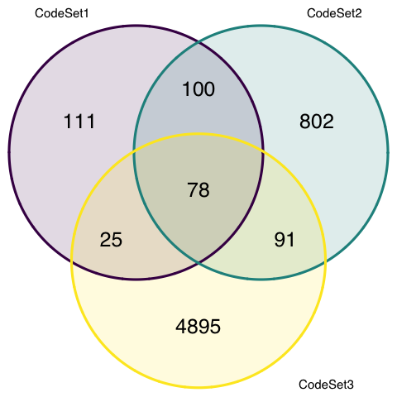
Methods: Common samples and genes
78 common summary IDs
72 common genes
CodeSet1
93 samples
CodeSet2
87 samples
CodeSet3
140 samples

Slide 8
Methods: CodeSets
Two methods were used to normalize data between CodeSets
Reference samples method:
CodeSet1 had samples that were repeated in either CodeSet2 or both CodeSet2 and CodeSet3.
Common samples and genes were used as reference sets.
Reference pools method:
Reference pool samples were present in both CodeSet2 and CodeSet3
Normalization was done following the PrOType method for HGSC subtypes

Slide 9
Normalization of training sets
Reference samples method
72 common genes across all three CodeSets for use as references
Number of samples used to norm: duplicates?, common any3_ref? (PLOS paper) any5_ref? 10? 15?
Ref-normalized datasets: normalized to housekeeping genes, normalized to the 72 common reference genes, filtered for the five major histotypes of interest
CodeSet1, CodeSet2, CodeSet3
Reference pools method
CodeSet2 contains 9 ref pool samples (Pool 1 = 3, Pool 2 = 3, Pool 3 = 3)
CodeSet3 contains 22 ref pool samples (Pool 1 = 12, Pool 2 = 5, Pool 3 = 5)
Pools-normalized datasets: normalized to housekeeping genes, normalized to pool samples, filtered for the five major histotypes of interest
CodeSet2, CodeSet3

Slide 10
Normalization validation
How well are we correcting expression via normalization?
Does expression of samples reproduced in multiple CodeSets fall on the same identity line?
How tight are samples to line (precision)
Shifted (accuracy)
Pearson’s correlation coefficient (R) for precision
Coefficient of accuracy (C_{a}) for accuracy/systemic bias
Lin’s concordance correlation (R_{c} = R ⋅ C_{a}) for precision and accuracy simultaneously

Slide 11
Normalization validation strategy
CodeSet2 vs 3
ref2 vs ref3
pool2 vs pool3
non2 vs non3
CodeSet1 vs 2 vs 3
ref1 vs ref2, ref1 vs ref3, ref2 vs ref3
non1 vs non2, non1 vs non3, non2 vs non3

Slide 12
Classifier training and validation datasets
Which CodeSets to use as training/validation?
Which normalization methods to use moving forward to classifier training?
If similar results, use reference samples method for convenience in paper?
Option A:
Train classifier using CodeSet3
How many predictive genes in CS3 are in CS1 and CS2
Correlated genes to replace missing?
Validate classifier on CS1 and CS2
Option B:
Train classifier using half of CodeSet3
Option C:
Train classifier using half of CS3 and half of CS2

Slide 13
Histotype classifier development
6 classification algorithms and 4 subsampling methods across 500 repetitions in a supervised learning framework
Classifiers:
Random Forest
Adaboost
XGBoost
LDA (latent Dirichlet allocation)
Support vector machine
K-Nearest Neighbours
Subsampling:
None
Down-sampling
Up-sampling
SMOTE (Synthetic Minority Over-sampling Technique)
Derek – does smote down-sample as well as synthetically up-sample?
Notes:
ROSE uses smoothed bootstrapping to draw artificial samples from the feature space neighbourhood around the minority class.
SMOTE (Synthetic Minority Over-sampling Technique) draws artificial samples by choosing points that lie on the line connecting the rare observation to one of its nearest neighbors in the feature space.
SMOTE and ROSE down-sample the majority class and synthesize new data points in the minority class

Slide 14
Distribution of histotypes
revHist | CS1 | CS2 | CS3 | CS1_percent | CS2_percent | CS3_percent
CCOC | 57 | 68 | 182 | 17.3 | 7.2 | 6
ENOC | 61 | 30 | 272 | 18.5 | 3.2 | 9
HGSC | 169 | 757 | 2453 | 51.4 | 80.1 | 80.9
LGSC | 22 | 29 | 50 | 6.7 | 3.1 | 1.6
MUC | 20 | 61 | 77 | 6.1 | 6.5 | 2.5

Slide 15
CS1 Ref-Norm Training Set
CS1 Ref-Norm Training Set
CCC | 57
ENOC | 59
HGSC | 156
LGSC | 16
MUC | 16
Alg: svm, rf, adaboost
Sub: none or up
Alg: svm
Sub: none
Notes:
>Accuracy is used when the True Positives and True negatives are more important while F1-score is used when the False Negatives and False Positives are crucial.
>F1-score is a better metric when there are imbalanced classes

Slide 16
CS1 Ref-Norm Training Set
CS1 Ref-Norm Training Set
CCC | 57
ENOC | 59
HGSC | 156
LGSC | 16
MUC | 16
Alg: svm – particularly in LGSC
Sub: none
Sub: up slightly ↓ in MUC
Notes:
25 duplicate genes common with CS3

Slide 17
CS2 Pools-Norm Training Set
CS2 Pools-Norm Training Set
CCOC | 68
ENOC | 30
HGSC | 757
LGSC | 29
MUC | 61
Alg: svm, rf, adaboost, knn
Sub: none, up, smote
Alg: svm
Sub: none

Slide 18
CS2 Pools-Norm Training Set
CS2 Pools-Norm Training Set
CCOC | 68
ENOC | 30
HGSC | 757
LGSC | 29
MUC | 61
Alg: svm – particularly in LGSC , ENOC
Sub: none or smote

Slide 19
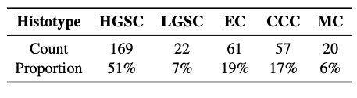
Cathy’s thesis analysis
Used 3 performance metrics
F-score - measure that balances precision and recall. More informative than accuracy when evaluating performance of minority classes
G-mean - more sensitive in capturing bad minority class performance due to its multiplicative feature
Kappa - Measures agreement between the actual classes and the predicted classes, correcting for the amount of agreement due to pure chance
Used CodeSet1

Slide 20
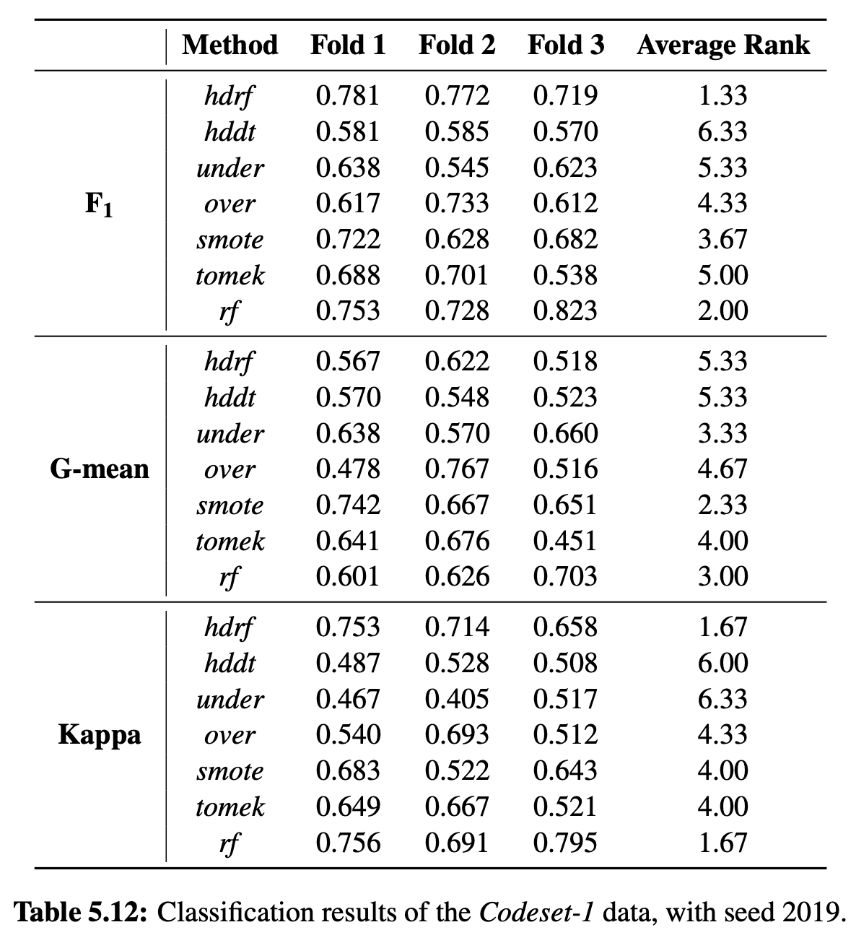
Cathy’s thesis analysis
Results are statistically tested using the Friedman rank sum test with post-hoc pairwise comparisons
Summarizes overall performance using the average rank
Smaller ranks indicate better performances
Top 3 methods (mostly based on F1)
hdrf - random forest version of the Hellinger Distance Decision Tree
random forest
smote – SMOTE followed by C50 decision tree - Synthetic Minority Over-sampling Technique to generate artificial instances of minority class

Slide 21
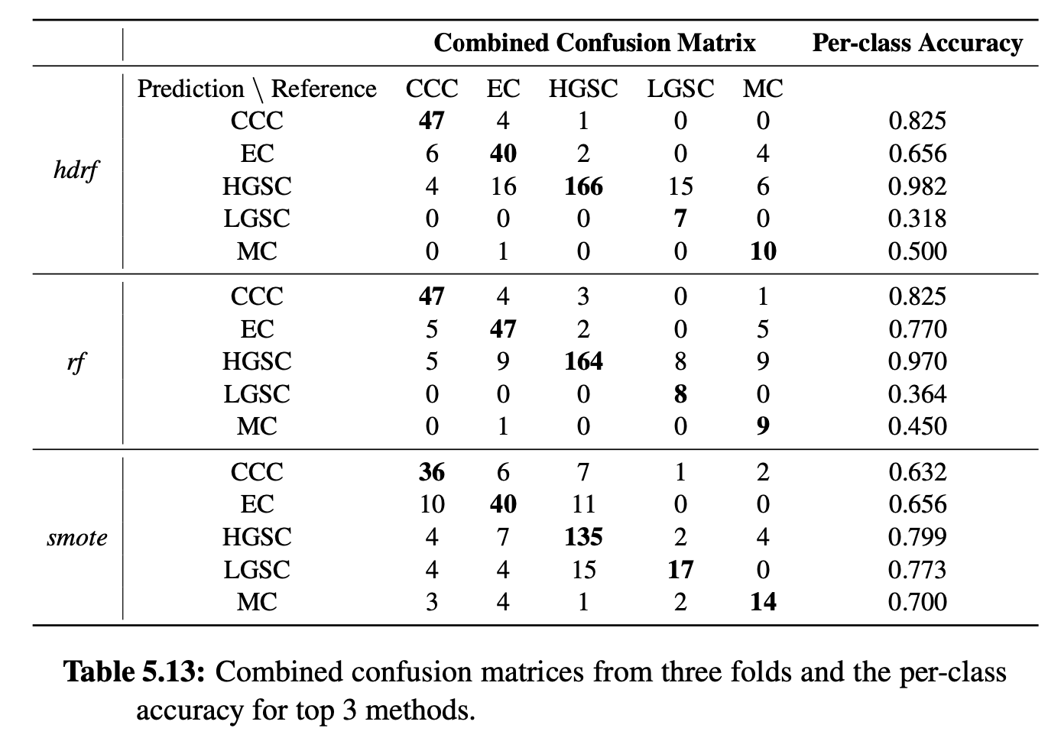
Cathy’s thesis analysis
Majority class (HGSC)
hdrf and rf - good
smote - moderate
Medium class (CCC, EC)
hdrf and rf - moderate
smote - poor
Small class (LGSC, MC)
hdrf and rf -poor
smote - moderate
*per-class accuracy is calculated as the diagonal entries divided by column sums

Slide 22
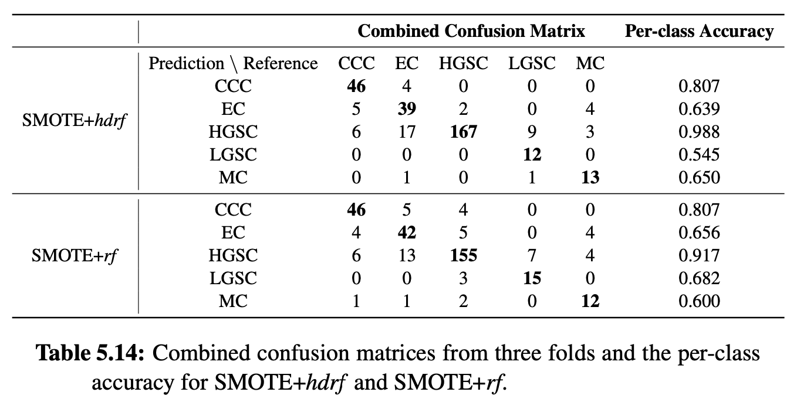
Cathy’s thesis analysis
Improvements:
SMOTE for LGSC and MC (up to 50)
Apply hdrf and rf methods as the classifiers

Slide 23
Cathy’s thesis analysis
SMOTE improves classification accuracy for LGSC and MC for both hdrf and rf but the performance of other classes may decrease

Slide 24
Cathy’s thesis analysis: Conclusions
Overall classification results for CodeSet1 were only moderate
Potential reasons
Small sample size
Potential overlap of expression values for different histotypes
F1 and Kappa can still be dominated by the majority class performance
Modified random forest Hellinger Distance Decision Tree algorithm is an option for imbalanced datasets

Slide 25
Next steps:
Classifier development:
Add hdrf algorithm to classifier comparisons
Add smote upsampling for minority classes only
Add G-mean and Kappa statistics (in addition to F1 and accuracy)
Discussion points:
Which scheme to normalize to reference samples
Duplicates, common any3_ref, any5ref, 10, etc.
Which comparison strategy to use
Ref-vs-ref etc?, cross-compare normalization methods?
Which CodeSets to use as training vs validation

